Slide 1
Industrial Engineering & Management lesson(8)

Slide 2
2.1.3.1 Data Presentation. Cost data are stated as purchased, delivered, or installed costs. Purchased cost is the price of the equipment FOB (free on board) at the manufacturer’s plant. Delivered cost is the price of the equipment plus delivery charges to the purchaser’s plant FOB.
Some cost data are reported as installed cost.
This means the equipment item, for example, a centrifugal pump has been purchased, delivered, uncrated, and placed on a foundation in an operating department but does not include piping, electrical, insulation costs. Perhaps a more accurate term would be set-in place cost

Slide 6
Correlations for base cost, design type factor, material of construction
factor, and design pressure factor can be developed as secondary algorithms: Base cost: Equation (1) is known as the six-tenths or 0.6, rule. This equation permits the user to obtain a cost for an equipment item of a different size when the cost for given size is known. For most process equipment, the exponent varies between0.4 and 0.8 with an average value of about 0.6. When the exponent is unknown, this value may be used. Typical equipment cost-capacity exponents are found in
Table 4.4. An extensive list of cost-capacity exponents was published by Remer and Chai in 1990 .

Slide 11
2.1.5 Cost Indexes
Cost data are presented as of a specific date. They are adjusted through the use of cost indexes that are based upon constant dollars in a base year and actual dollars in a specified year

Slide 14
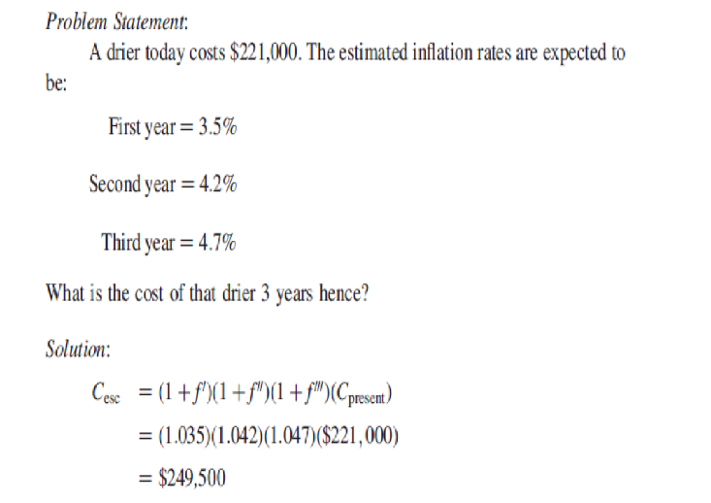

Slide 15
2.1.5.1 Marshall and Swift Cost Index (M&S).
The Marshall and Swift Index, originally known as the Marshall and Stevens Index, was established in the base year, 1926, with a value of 100. The index is reported as a composite of two major components, namely, a process-industry equipment average and all industry equipment average.
2.1.5.2 Chemical Engineering Index (CE). The Chemical Engineering Index was established in the early 1960 s using a base period of 1957–1959 as 100.
2.1.5.3 Nelson–Farrar Indexes (NF). The Nelson–Farrar Indexes were
originally known as the Nelson Refinery Construction Indexes
The choice of the index to use is based upon the industry in which the person works. An engineer in the petroleum or petrochemical business might find the NF Index suitable. In the chemical process industries, either the CE or the M&S are adequate.

Slide 16
2.2 Estimation of Fixed capital investment
Numerous techniques are available for estimating the fixed capital investment. The methods vary from a simple single factor to a detailed method using a code of accounts that involves item-by-item costing.
2.2.1 Order-of-Magnitude Estimates
A project scope is essential before preparing an estimate irrespective of the quality of the estimate.

